Slide 1
Thermodynamics 1
Physics Club 2025-2026

Slide 2
Objectives
01
02
03
04
05
06
What, Why Thermodynamics?
Work & Energy
Heat & Heat Transfer Processes
1st Law of Thermodynamics
Ideal Gas
Thermal Energy Transfer

Slide 3

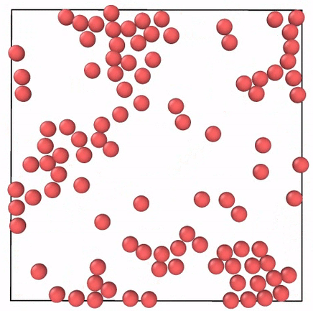
What, Why Thermodynamics?
Thermodynamics is the study of heat and how energy flows within objects. (Thermo - heat, Dynamis – power or energy)
We can use Thermodynamics to generalize motion of tiny molecules into a object we can predict the behavior of.
We can (probably) track the motion of an atom moving through basic mechanics, but it gets progressively more difficult until realistically we would have to track billions at once using solely mechanics.
We instead resort to using a quantity called energy (ability of an object to do something) to describe the motion of a group of particles.

Slide 4
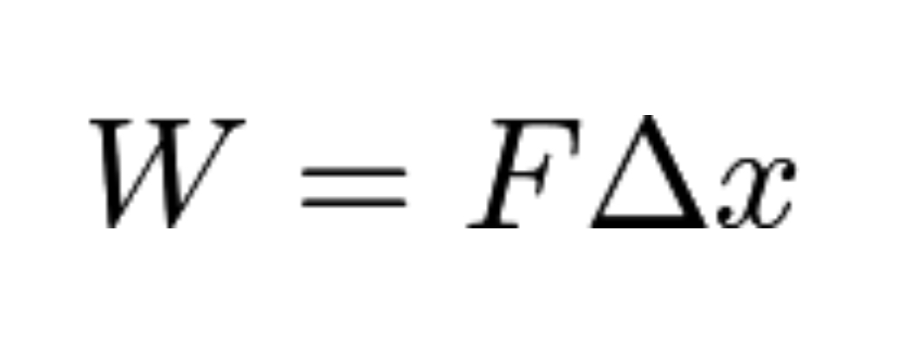
Idea of Energy and Work
Energy
Work
As stated earlier, energy is the ability to do something. In Thermo, this quantity is defined as U - which is what we call internal energy(Note throughout physics this is what we usually refer as energy). The units for energy is Joules (J)
Work in Physics can be thought of as the transfer of energy. If I do work on a block, that means I transferred energy into the block (which will move consequentially) through work - I did work on the block. Notice the keyword “on” and “by” as we go further into talking about transfer of energy.

Slide 5
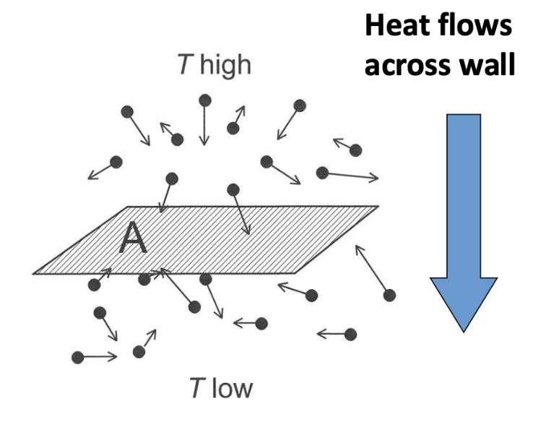
Heat
Textbook definition: Heat is energy that flows between a system and its environment because of a temperature difference between them.
Flow of energy
Caused by difference of temperature (Average “amount of movement” of each particles we focus on)
(Ice in hot water example)

Slide 6

First Law of Thermodynamics
∆U = Q+W
∆U is the change in internal energy
Q is the amount of heat into the system
W is the work done on the system

Slide 7
Ideal Gas Law
PV = nRT, where P is pressure of system, V is volume of system, n is number of molecules in the system, R is gas constant of the molecules in the system, and T is the temperature of the time.(Think of these variables as proportional relationships by some multiplier of constants)
Both sides of the equation have units of Joules
From the definition of work, we can derive definition of work using pressure and volume
W = Fx
Pressure P = F/A by definition
F = P * A
W = P * A * x
W = PV (in J)
[example: PV=mRT & P=pRT form, R is gas constant for the former, specific gas constant for the latter]

Slide 8
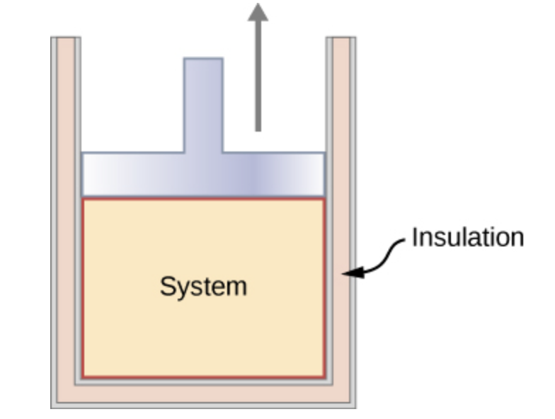
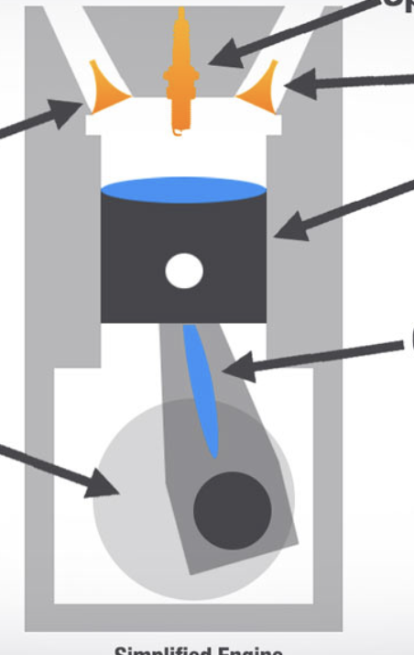
Example: Piston
Let’s say we have this insulated container(not allowing energy to escape the system) and some gas trapped by the piston. The system will only encapsulate the extent to which the gas will go

Slide 9
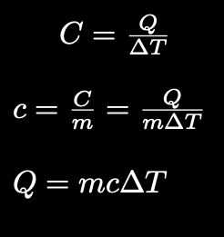
Before we move on…..
Note 1
Specific heat capacity constant c can change depending on the situation as you will see in later example.
Heat capacity, Specific heat capacity, and general relationship with heat
Note 2
Q is heat transferred into the system.
∆T is the change in temperature of the system
m is the mass of the system

Slide 10
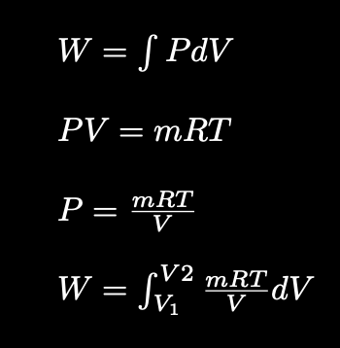
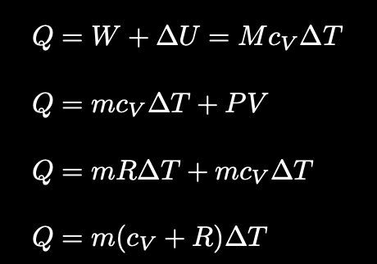
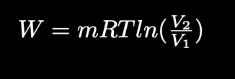

02
Piston processes
01
04
03
Isothermal
Temperature doesn’t change(∆T = 0)
W = Q (on the system)
Isobaric
Pressure is constant (W=PV)
Adiabatic
Isochoric/Isovolumetric
0 heat-associated energy transfer into or out of the system
∆U = W + Q(0) => ∆U = W
Polytropic process: PV^{ɣ} = constant, where gamma is Ɣ = C_{p}/C_{v} [Derivation of Work if there’s time, next lecture otherwise]
Volume is constant (W=0)
Notes:
Q(into)=W(out of)+∆U

Slide 11
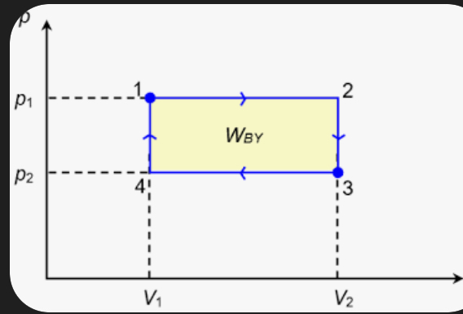

Isochoric + Isobaric process example

Slide 12
Thermal Energy Transfer Processes
Convection
Conduction
Radiation
Transfer of heat through contact.
Cycle of heat transfer within a medium where higher temperatures move towards the top(heated) and lower temperatures move toward the bottom(cooled)
Energy can be transferred into an object by some beam of energy from outside source such as fire or microwave radiation

Slide 13

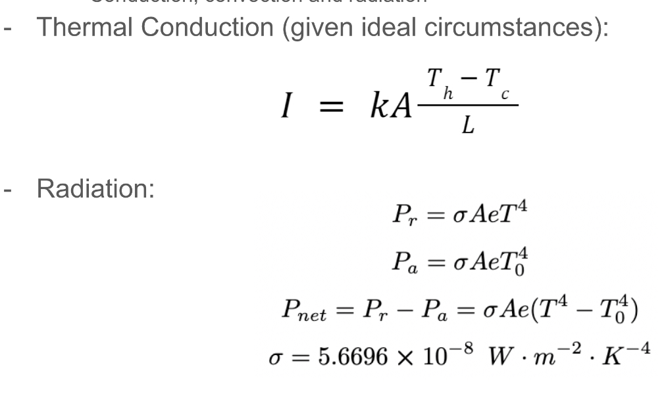
Thermal Energy Transfer
For conduction, we define thermal energy as such.

Slide 14
Thank you all for listening!
Do you have any questions?
Ask any of us! :)

