Slide 1
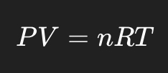
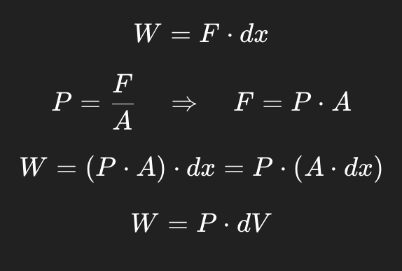
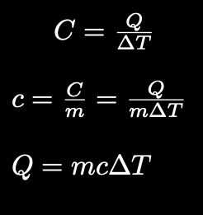
Before we move on….. Let’s review!!
First Law of Thermodynamics
∆U = Q+W
Ideal Gas Law
Heat Capacity

Slide 2
Thermal Energy Transfer Processes
Convection
Conduction
Radiation
Transfer of heat through contact.
Cycle of heat transfer within a medium where higher temperatures move towards the top(heated) and lower temperatures move toward the bottom(cooled)
Energy can be transferred into an object by some beam of energy from outside source such as fire or microwave radiation

Slide 3
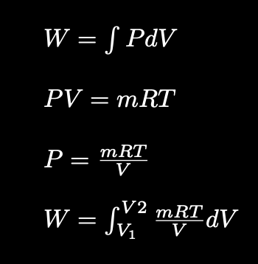
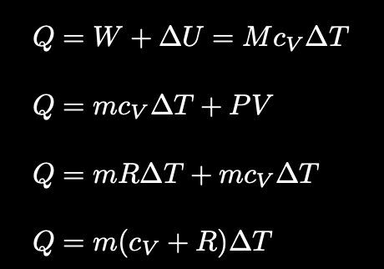
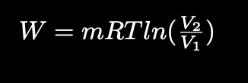

02
Piston processes
01
04
03
Isothermal
Temperature doesn’t change(∆T = 0)
W = Q (on the system)
Isobaric
Pressure is constant (W=PV)
Adiabatic
Isochoric/Isovolumetric
0 heat-associated energy transfer into or out of the system
∆U = W + Q(0) => ∆U = W
Polytropic process: PV^{ɣ} = constant, where gamma is Ɣ = C_{p}/C_{v} [Derivation of Work if there’s time, next lecture otherwise]
Volume is constant (W=0)
Notes:
Q(into)=W(out of)+∆U

Slide 4
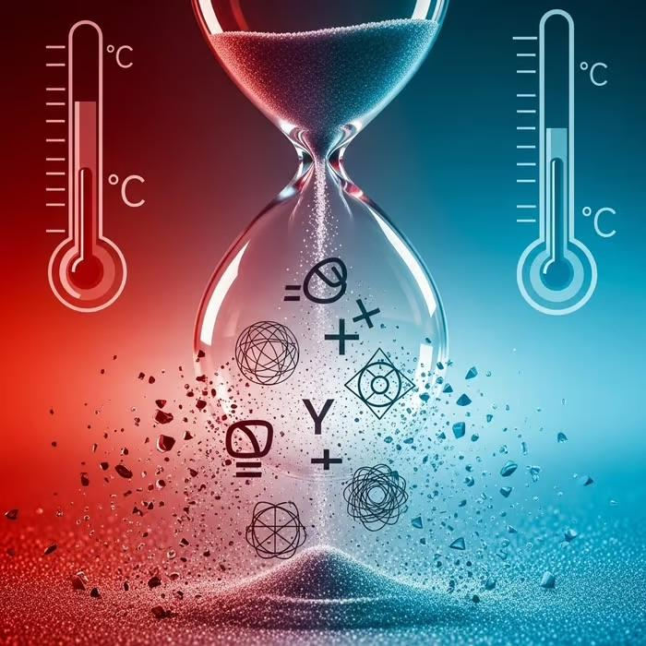
Thermodynamics 2
Physics Club 2025-2026

Slide 5
Contents
01
02
03
04
Introduction to the second law of Thermodynamics
Heat Engines
Refrigeration
Entropy

Slide 6
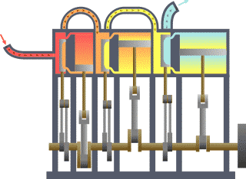

Introduction
The Second Law of Thermodynamics establishes that natural processes have a preferred direction and that energy spontaneously tends to disperse or spread out. It explains that while energy is conserved, not all heat energy can be perfectly converted into useful work. This law also explains why certain processes, such as heat flowing from hot to cold, occur spontaneously and why chaos energy, or entropy, is irreversible in the universe.

Slide 7
Introduction
The Kelvin-Planck Statement - No system can absorb heat from a single reservoir and convert it entirely into work without additional net changes in the system of its surroundings
Clausius Statement - A process whose only net result is to absorb heat from a cold reservoir and release the same amount of heat to a hot reservoir is impossible

Slide 8
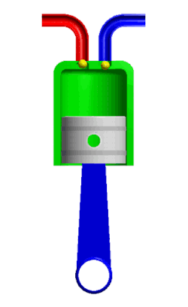
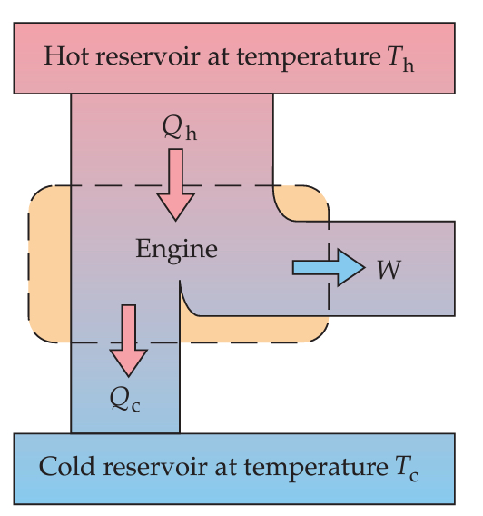
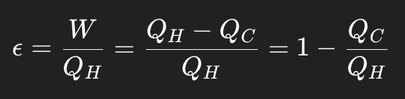
Heat Engine
Heat engines work by converting usable heat energy into mechanical work. In each cycle it includes 4 phases:
Gas heated by a working substance in either a isochloric or isothermic process
Gas undergoes adiabatic expansion. Mechanical work is done BY the system.
Gas returns back to a lower temperature in either a isochloric or isothermic process, losing heat.
Gas undergoes adiabatic compression, mechanical work is done ON the system.
The efficiency of the engine is given by
Notes:
B to C - the gas in the piston is cool, but is heated by a working substance in an isochloric process
C to D - now heated, the gas undergoes an adiabatic expansion. Mechanical work is done given by W=∫​​PdV
D to A - the gas now at an expanded state, loses some of its heat and returns back to a lower temperature in an isochloric process
A to B - now cooled down, the gas undergoes adiabatic compression and returns back to its beginning state

Slide 9
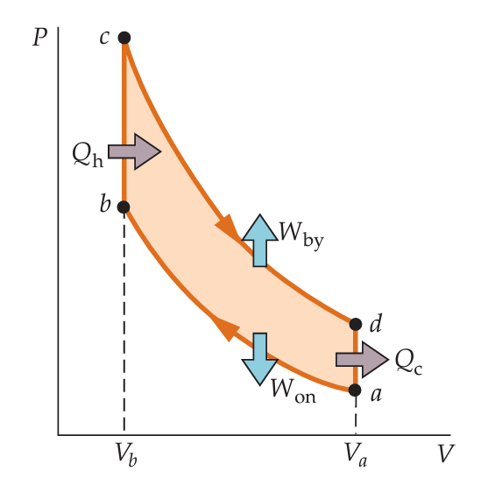
Otto cycle
B to C - the gas in the piston is cool, but is heated by a working substance in an isochloric process
C to D - now heated, the gas undergoes an adiabatic expansion. Mechanical work done by the system is given by:
D to A - the gas now at an expanded state, loses some of its heat and returns back to a lower temperature in an isochloric process
A to B - now cooled down, the gas undergoes adiabatic compression and returns back to its beginning state. Mechanical work done by the system is given by:
Notes:
B to C - the gas in the piston is cool, but is heated by a working substance in an isochloric process
C to D - now heated, the gas undergoes an adiabatic expansion. Mechanical work is done given by W=∫​​PdV
D to A - the gas now at an expanded state, loses some of its heat and returns back to a lower temperature in an isochloric process
A to B - now cooled down, the gas undergoes adiabatic compression and returns back to its beginning state

Slide 10
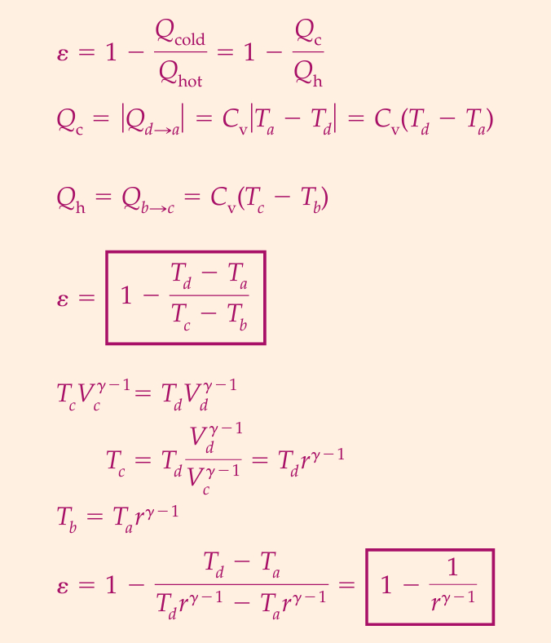
Otto cycle
Calculating its efficiency
Notes:
B to C - the gas in the piston is cool, but is heated by a working substance in an isochloric process
C to D - now heated, the gas undergoes an adiabatic expansion. Mechanical work is done given by W=∫​​PdV
D to A - the gas now at an expanded state, loses some of its heat and returns back to a lower temperature in an isochloric process
A to B - now cooled down, the gas undergoes adiabatic compression and returns back to its beginning state

Slide 11
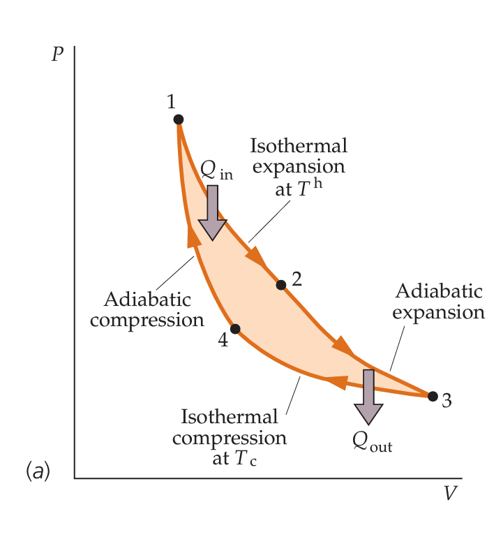
Carnot cycle
Carnot’s Theorem - No engine working between two given heat reservoirs can be more efficient than a reversible engine working between these two reservoirs.
The Carnot cycle is essentially the same thing as the Otto cycle except the isochoric heat processes are replaced with isothermal heat processes.
1 -> 2: Isothermal absorption of heat from a hot reservoir
2 -> 3: Adiabatic expansion to a lower temperature
3 -> 4: Isothermal release of heat to a cold reservoir
4 -> 1: Adiabatic compression back to the original state
Notes:
B to C - the gas in the piston is cool, but is heated by a working substance in an isochloric process
C to D - now heated, the gas undergoes an adiabatic expansion. Mechanical work is done given by W=∫​​PdV
D to A - the gas now at an expanded state, loses some of its heat and returns back to a lower temperature in an isochloric process
A to B - now cooled down, the gas undergoes adiabatic compression and returns back to its beginning state

Slide 12
Carnot cycle
Although the Otto Cycle is more realistic, The Carnot cycle is more efficient because it is perfectly reversible, extracting the maximum possible work from a given temperature difference. The Otto cycle wastes some potential work because heat is added/rejected at varying temperatures and processes are irreversible.
Conditions for reversibility
No mechanical energy is transformed into internal thermal energy by friction, viscous forces, or other dissipative forces.
Energy transfer as heat only occurs between objects with an infinitesimal difference in temperature.
The process must be quasi-static so that the system is always at or infinitesimally near an equilibrium state.
Notes:
B to C - the gas in the piston is cool, but is heated by a working substance in an isochloric process
C to D - now heated, the gas undergoes an adiabatic expansion. Mechanical work is done given by W=∫​​PdV
D to A - the gas now at an expanded state, loses some of its heat and returns back to a lower temperature in an isochloric process
A to B - now cooled down, the gas undergoes adiabatic compression and returns back to its beginning state

Slide 13
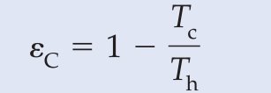
Carnot cycle
Notes:
B to C - the gas in the piston is cool, but is heated by a working substance in an isochloric process
C to D - now heated, the gas undergoes an adiabatic expansion. Mechanical work is done given by W=∫​​PdV
D to A - the gas now at an expanded state, loses some of its heat and returns back to a lower temperature in an isochloric process
A to B - now cooled down, the gas undergoes adiabatic compression and returns back to its beginning state

Slide 14
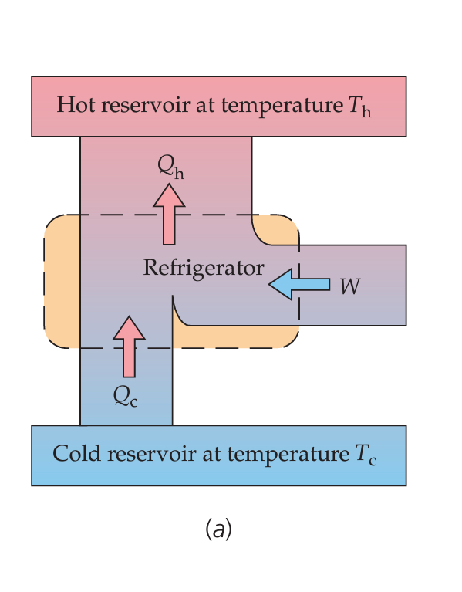
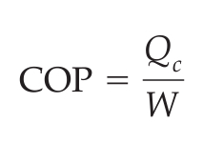
Refrigeration
Refrigeration is simply the opposite process in regards to the heat engine. In this case, work is added to get a colder reservoir to transfer heat to the hot reservoir
The efficiency of refrigeration the coefficient of performance is given by
Notes:
B to C - the gas in the piston is cool, but is heated by a working substance in an isochloric process
C to D - now heated, the gas undergoes an adiabatic expansion. Mechanical work is done given by W=∫​​PdV
D to A - the gas now at an expanded state, loses some of its heat and returns back to a lower temperature in an isochloric process
A to B - now cooled down, the gas undergoes adiabatic compression and returns back to its beginning state

Slide 15
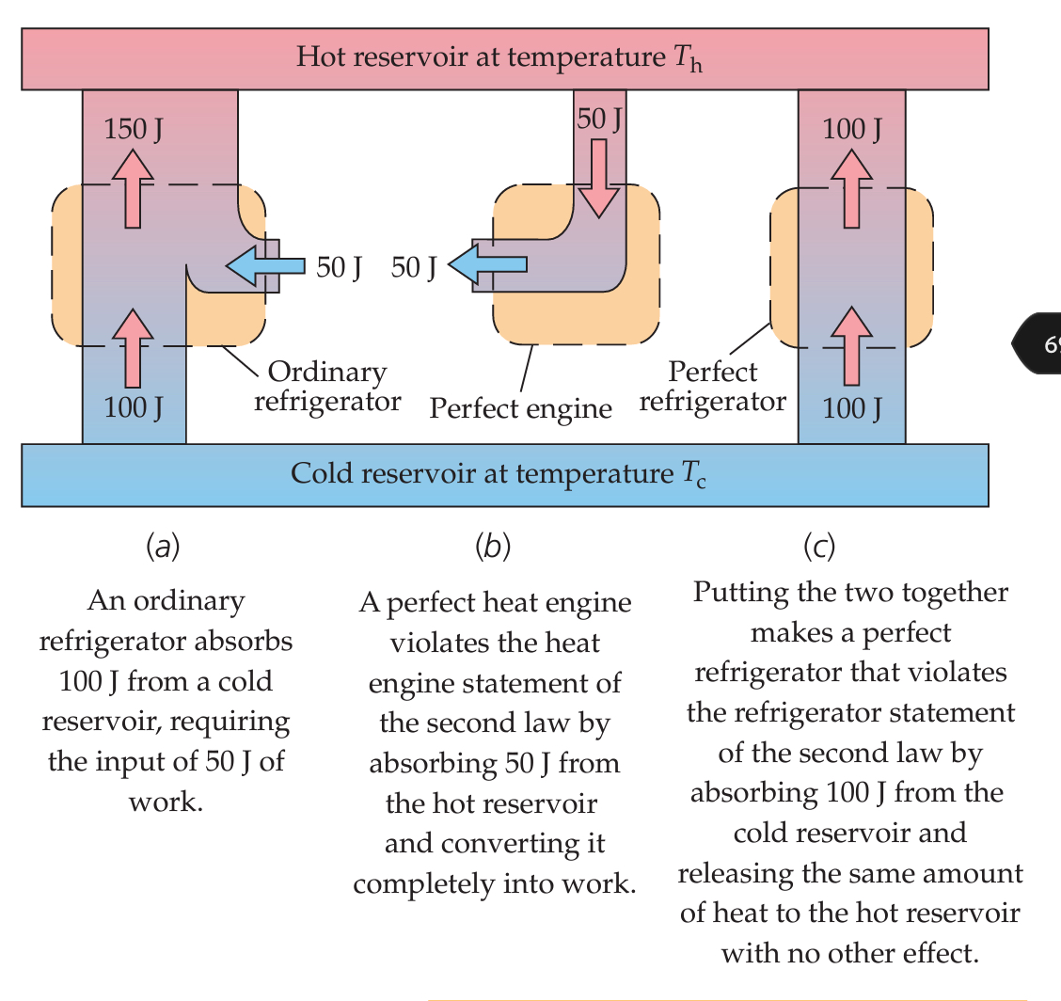
The Kelvin - Planck statement of the Second Law of Thermodynamics refers to the heat engine, as it refers to the conversion of heat into mechanical energy, saying it is impossible to have 100% efficiency
On the other hand, the Clausius statement refers to refrigeration, since it says it’s impossible to have a cold reservoir naturally heat up a hot reservoir.
Both statements are equivalent since if one is false, the other must be false
Notes:
B to C - the gas in the piston is cool, but is heated by a working substance in an isochloric process
C to D - now heated, the gas undergoes an adiabatic expansion. Mechanical work is done given by W=∫​​PdV
D to A - the gas now at an expanded state, loses some of its heat and returns back to a lower temperature in an isochloric process
A to B - now cooled down, the gas undergoes adiabatic compression and returns back to its beginning state

Slide 16


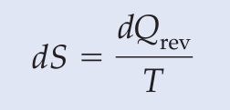
Entropy
Entropy is a measure of the disorderness of a system. As with potential and internal energy, since it is a relative term, what matters is the change in entropy of a system given by
Like potential energy, it is a state function, so the change in entropy only depends on the initial and final states, not by which processes that it got there
The entropy statement of the Second Law of Thermodynamics says that the change in entropy in the universe can only greater than equal to zero. In other words, chaos in the universe is always increasing.

Slide 17
Entropy with heat engines
In heat engines, using the definition of entropy, the hot reservoir will lose an entropy of QH​​/TH, and the cold reservoir will gain entropy QC/TC. Therefore the total entropy change in the universe would be - QH/TH + QC/TC
Now we relate Kelvin-Planck’s statement, which previously was explained to relate to heat engines, to the entropy statement.
If there really was a heat engine with 100% efficiency, then by the efficiency formula, Qc/Qh = 0, so Qc would be 0. In that case, unless Tc was 0, Qc/Tc would be 0. Since it is impossible to reach absolute zero,Qc/Tc would indeed be 0, and dS = - Qh/Th would be negative, violating the entropy statement.

Slide 18
Entropy with heat engines
In refrigerators, since the cold reservoir loses heat and the hot reservoir gains heat, the change in entropy would be -Qc/Tc + Qh/Th.
If Clausius’ law is false, and it is possible to have heat spontaneously flow from cold to hot, then both heat transfers will have the same value Q. Since Tc < Th and so 1/Tc > 1/Th, - Q/Tc + Q/Th would be negative again violating the statement of entropy.

Slide 19
Let’s practice!!

Slide 20
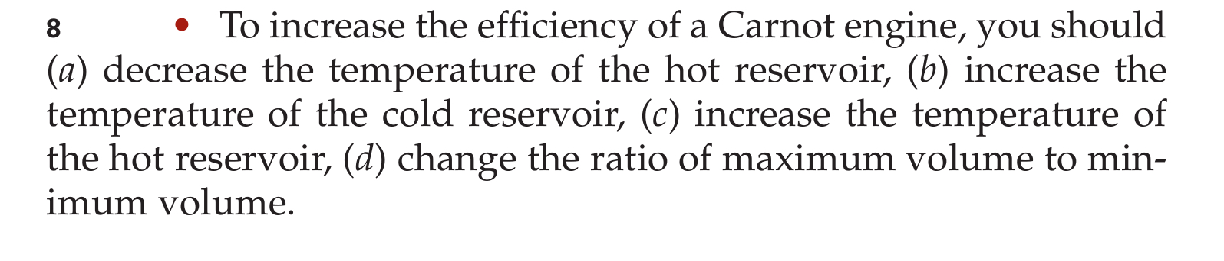
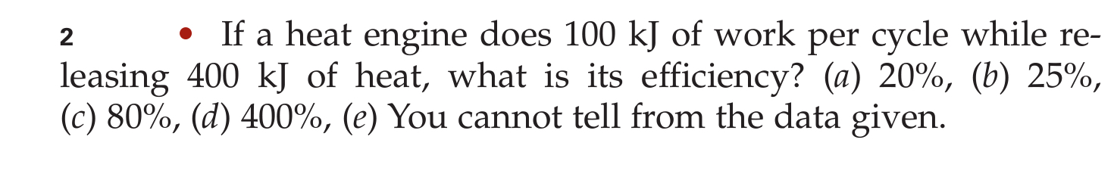
Let’s practice!!

Slide 21
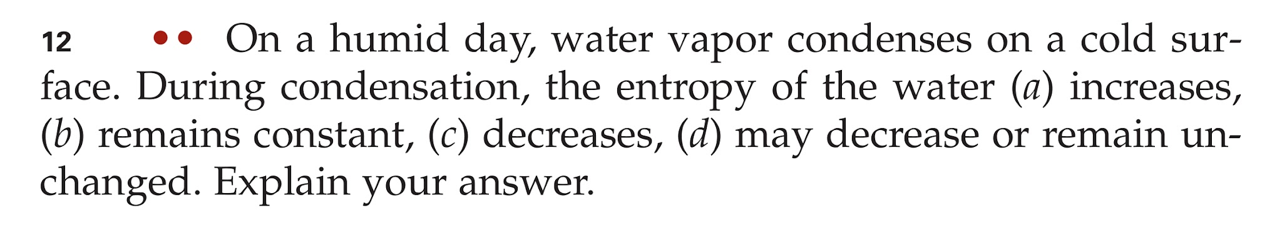
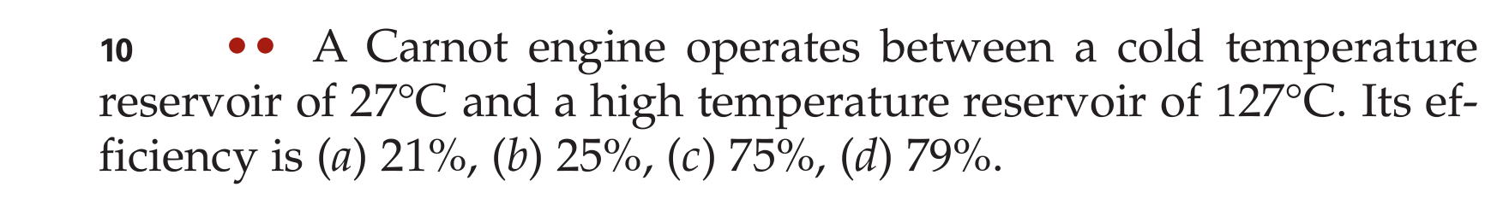
Let’s practice!!

Slide 22


Thank you all for listening!
Do you have any questions?
Ask any of us! :)

