Slide 1
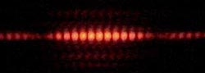
Optics 2
Physics Club 2

Slide 2
Outline
Physical vs Geometric Optics
Waves
Interference
Consequences of Interference

Slide 3
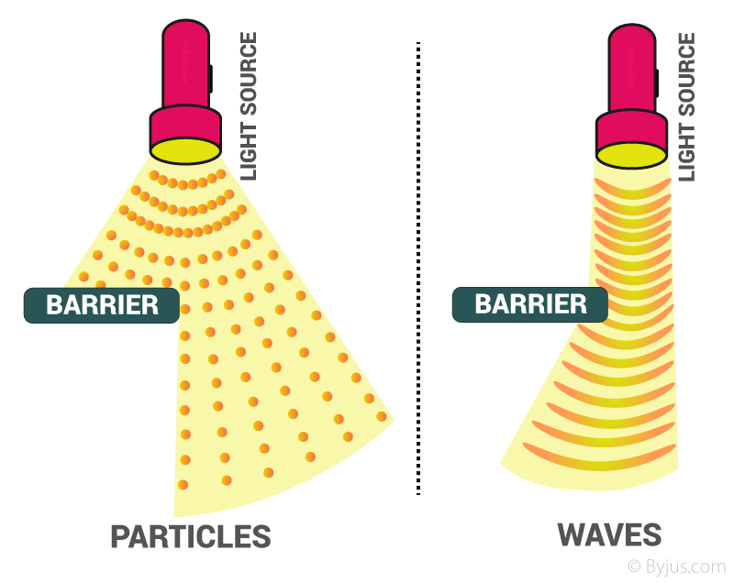
Physical vs Geometric Optics
Physical optics studies the wave nature of light
Geometric optics studies the particle nature of light

Slide 4
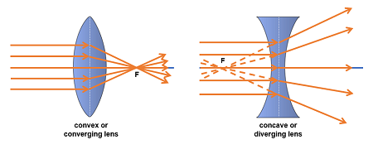
Review
Lenses: transparent optic devices that bend light and focus it.
Converging lenses(convex): bend light rays inward, converging at the focal point. (real & virtual, updown)
Diverging lenses (concave): spread light rays outward, causing them to diverge. (only virtual, upright)

Slide 5
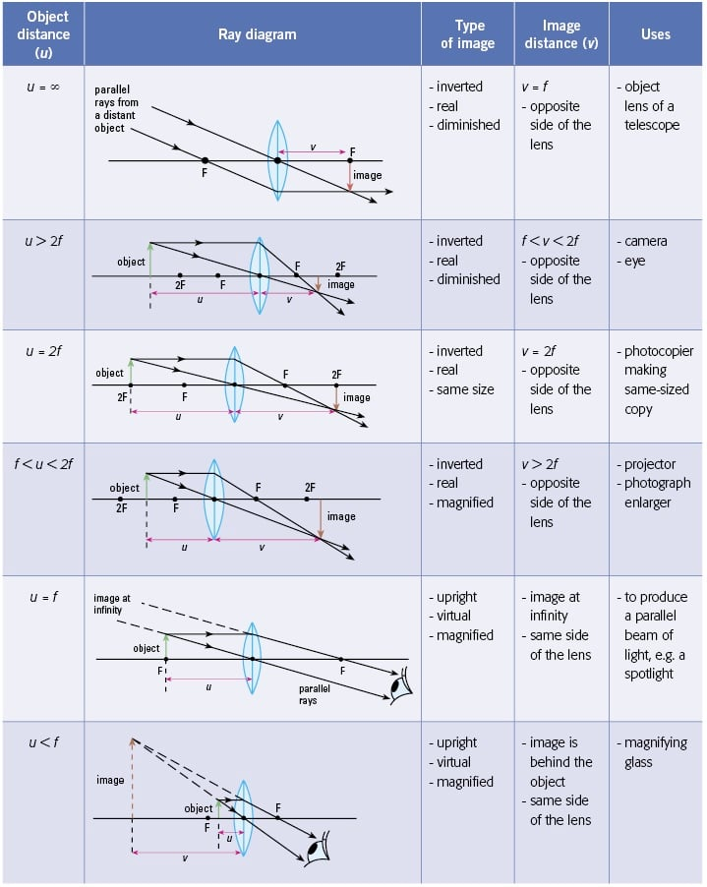
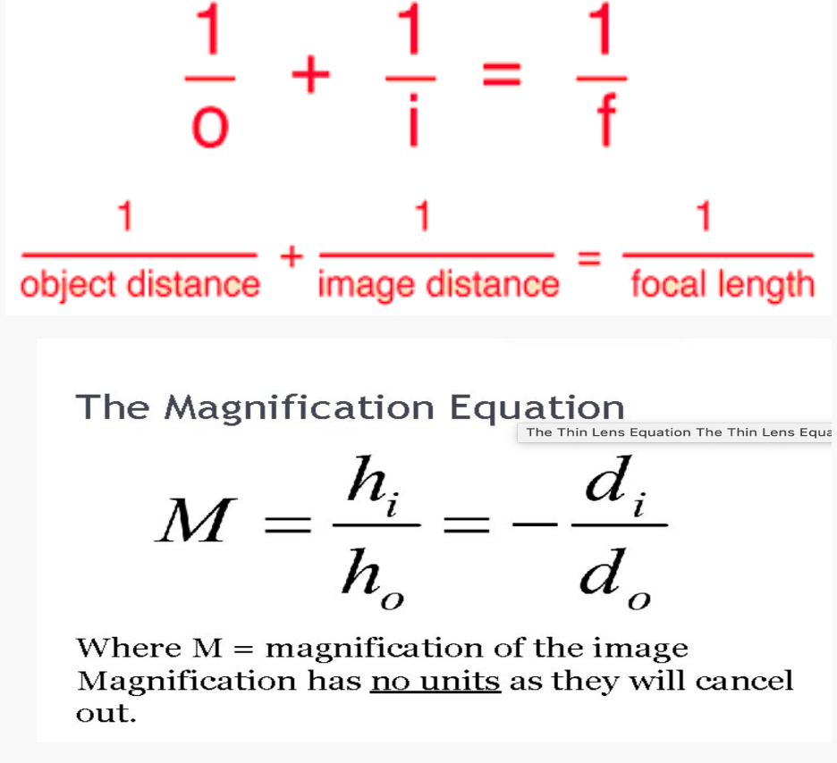
More review

Slide 6
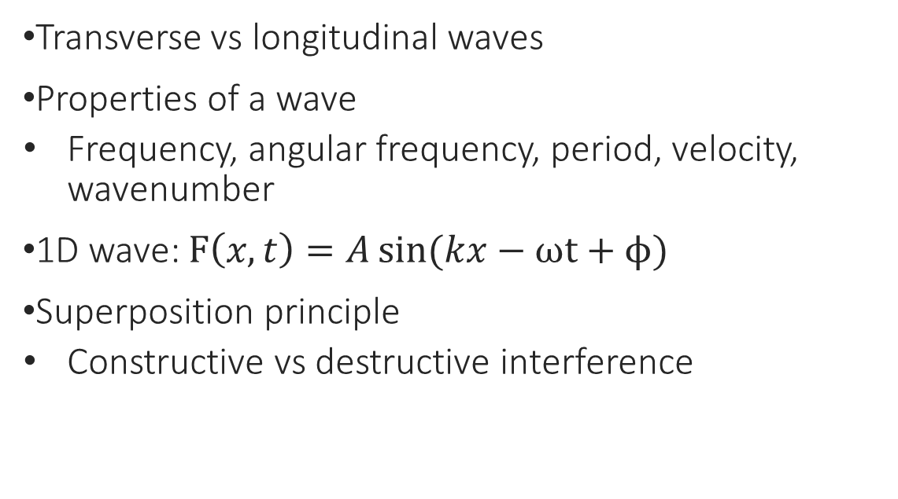
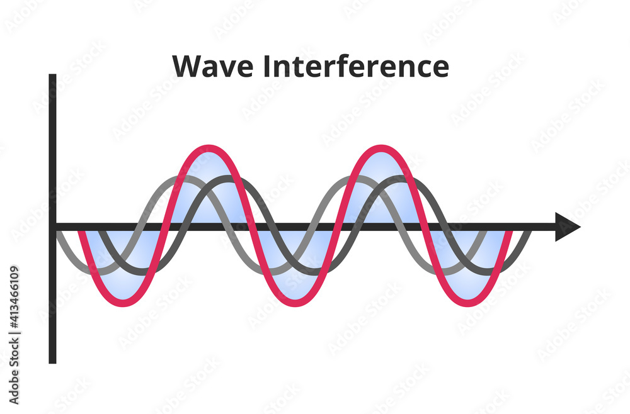
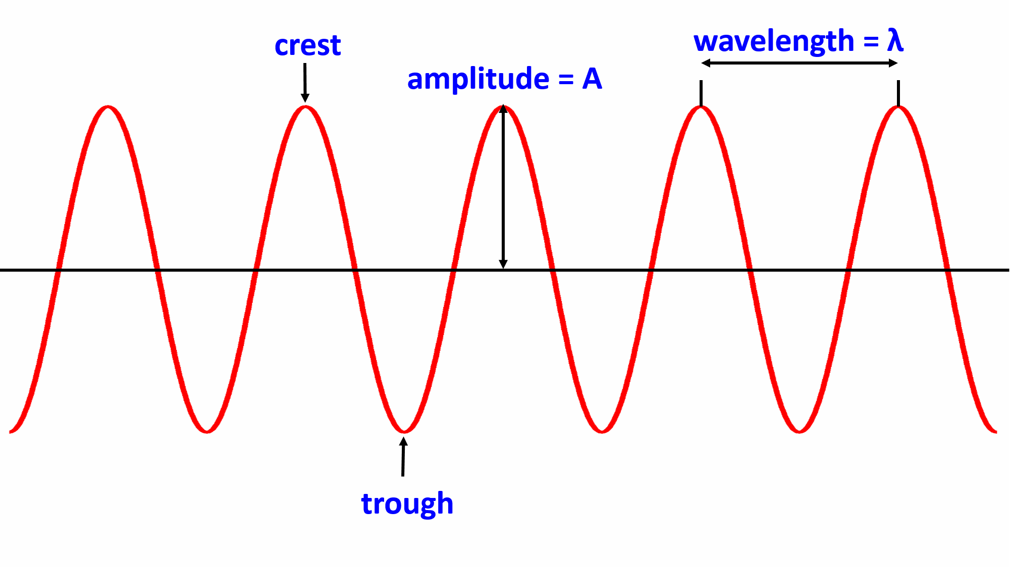
Waves

Slide 7
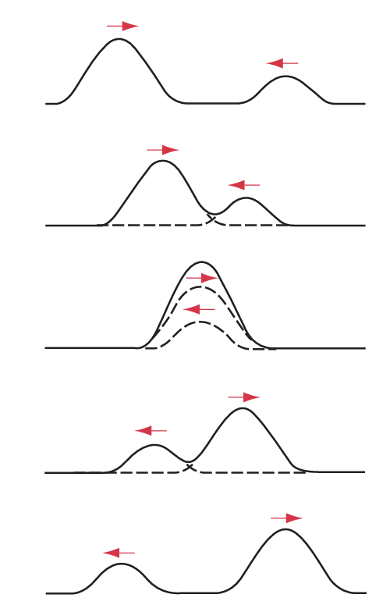
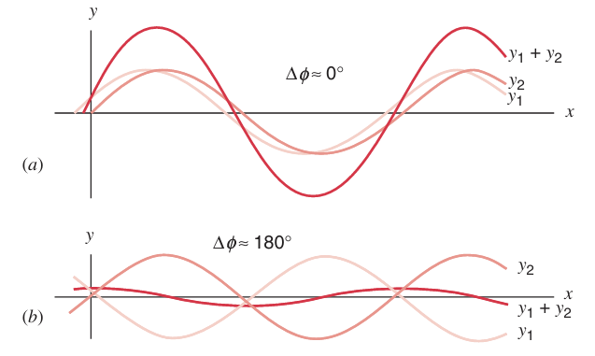

Wave Superposition And Interference
Interference occurs when two or more light waves superimpose (overlap) and interact, creating a new wave pattern.
When several waves combine at a point, the total wave amplitude at any given time is the sum of the amplitudes of the individual waves acting alone. The relative phase determines the total amplitude.

Slide 8

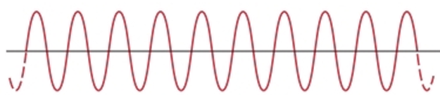
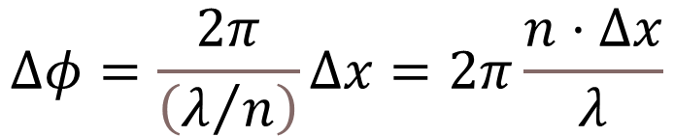
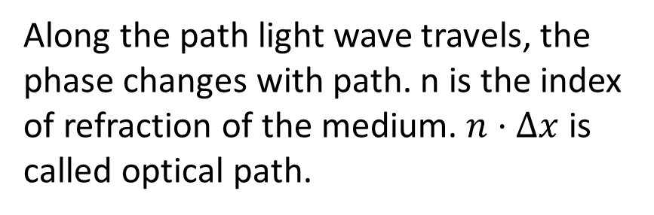
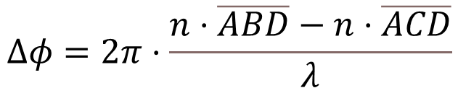
Optical Path Difference
B
path1
D
A
path2
C
If two light beams from same source A travel different path and meet again at D, the phase difference at D is:

Slide 9
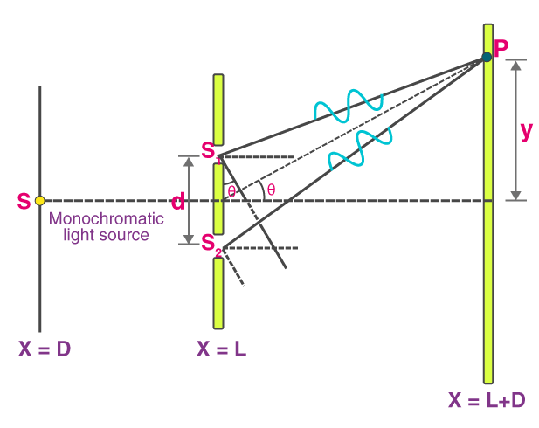

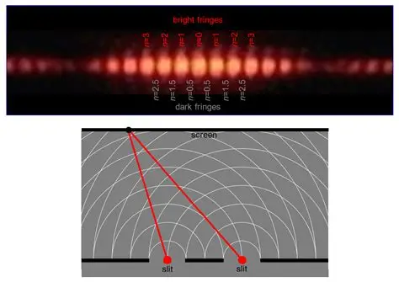
Double Slit Interference

Slide 10
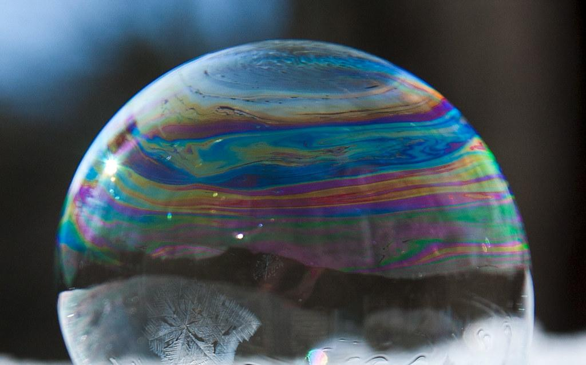
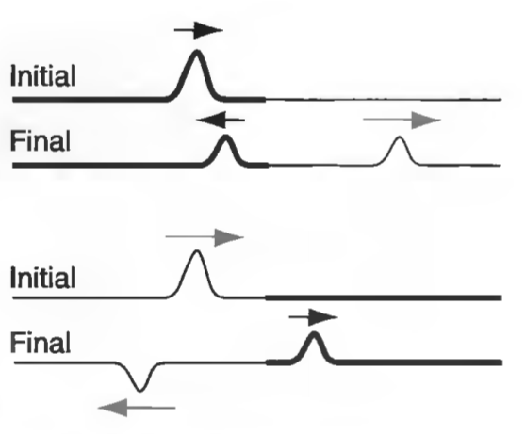

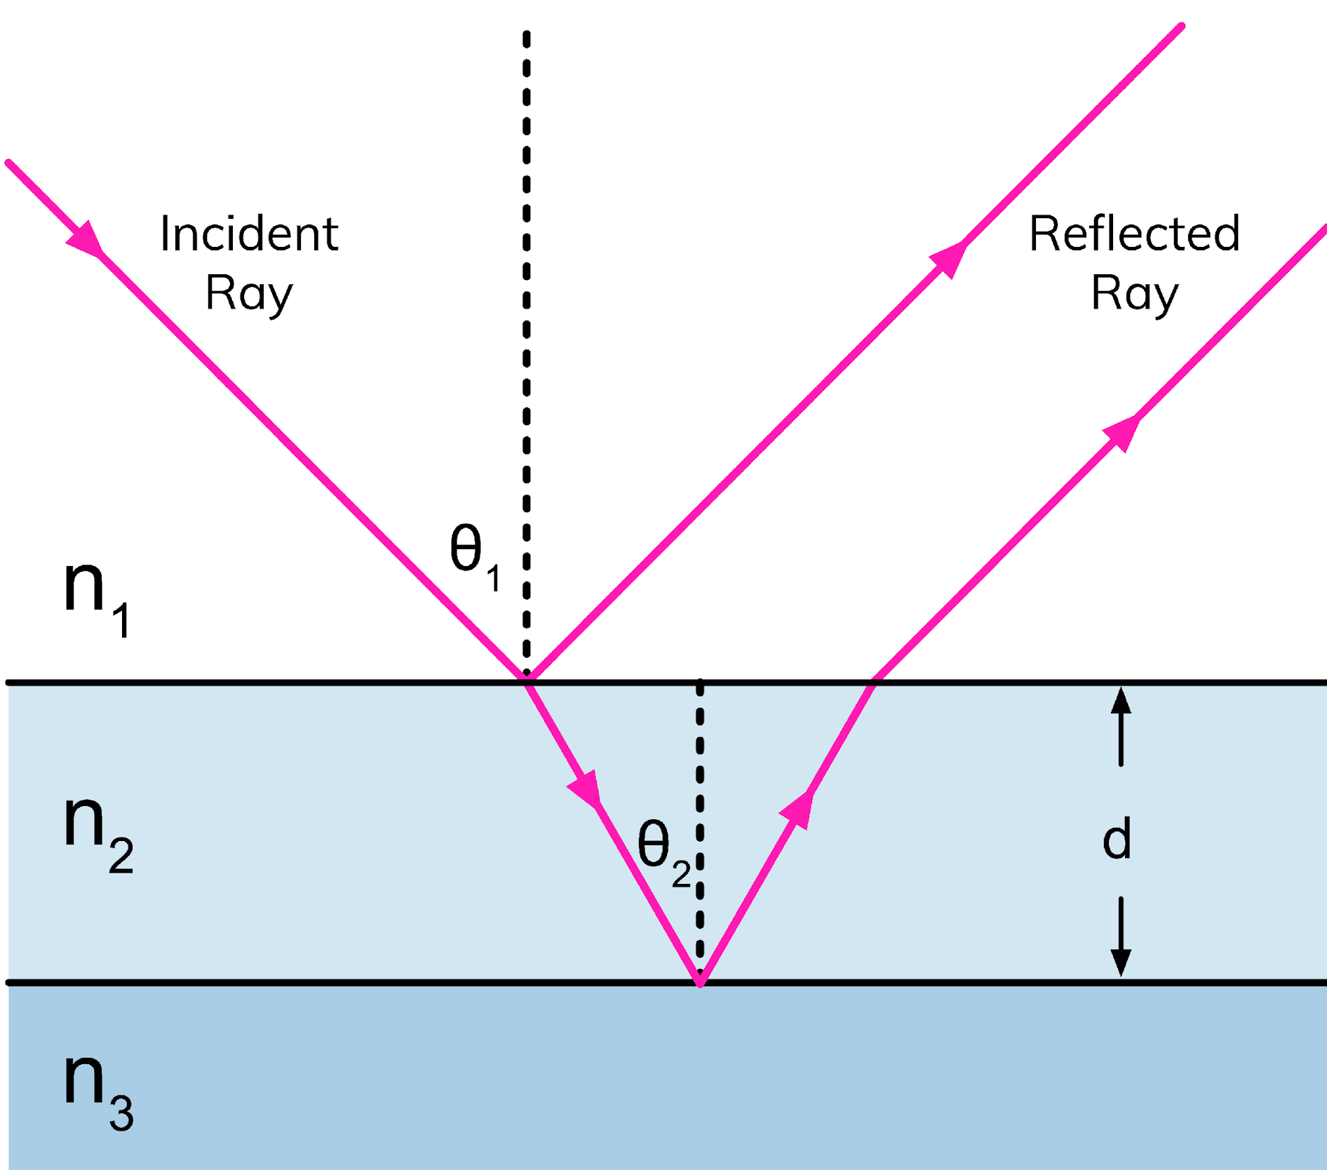
Thin Film Interference

