Slide 1
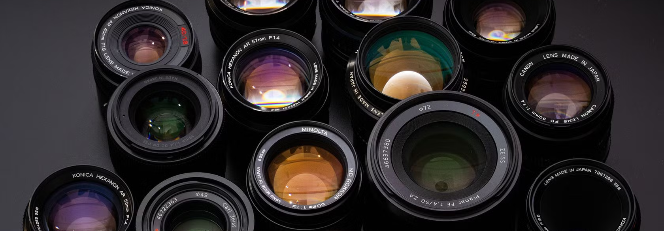
Optics 1
Physics Club 2

Slide 2
Outline
Physical vs Geometric Optics
Refraction
Lenses
Mirrors

Slide 3
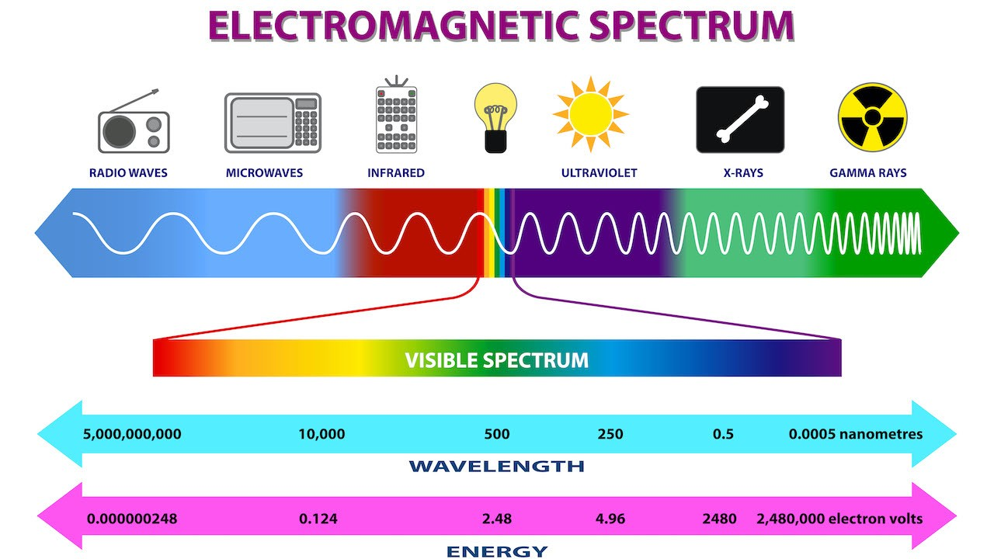
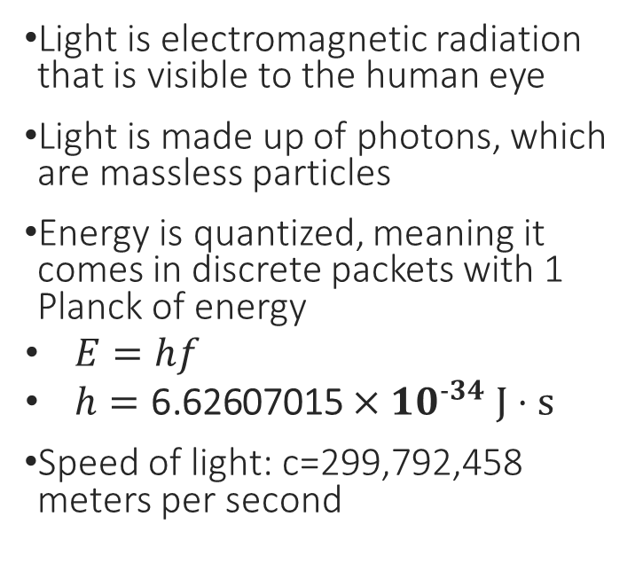
Light

Slide 4
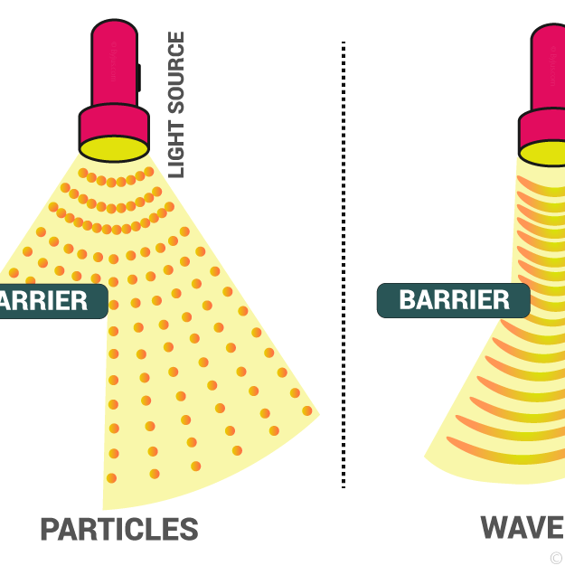
Physical vs Geometric Optics
Physical optics studies the wave nature of light
Geometric optics studies the particle nature of light

Slide 5
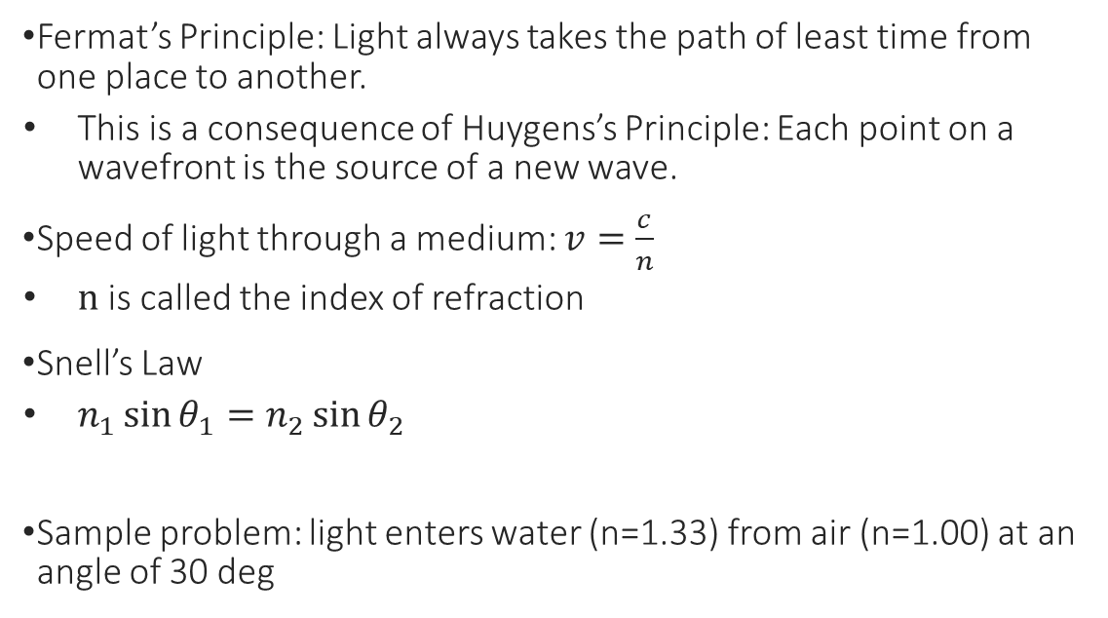
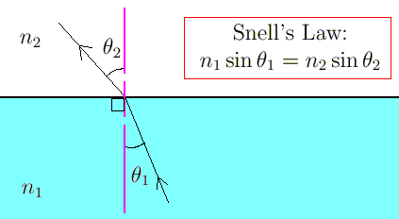
Fermat’s Principle and Snell’s Law

Slide 6
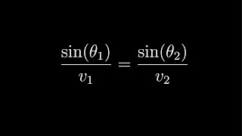
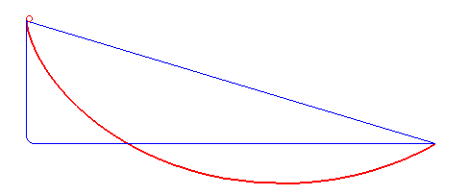
Brachistochrone Problem + Video Explanation

Slide 7
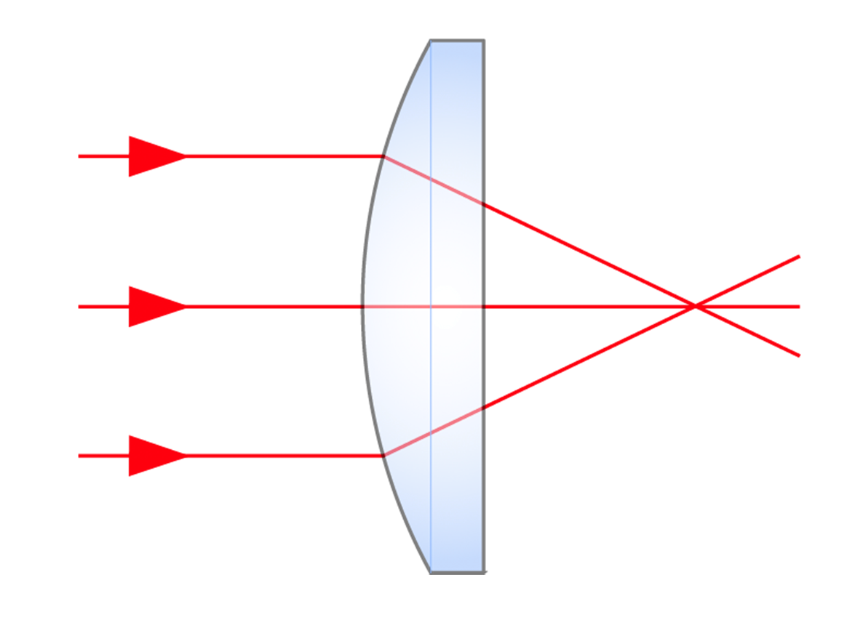
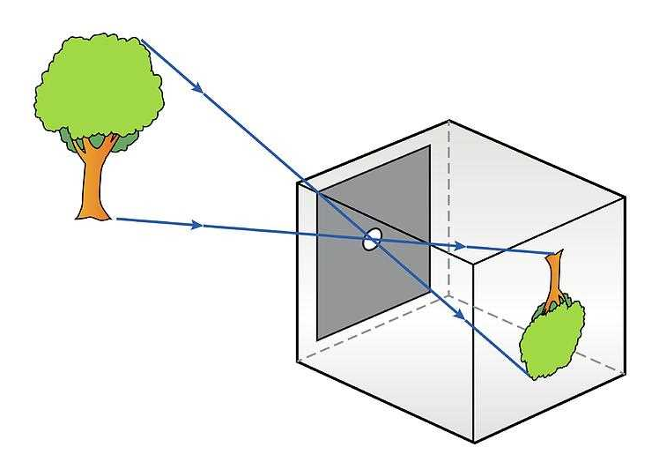
Lenses – Pinhole Camera
The simplest example of a camera is a pinhole camera
  It lets light through a small aperture to create an upside-down image
  Not much light is let in
If our hole is large, we essentially have many pinhole cameras that are all producing slightly misaligned images
The goal of a lens is to focus light so that we can have a bright and in focus image

Slide 8
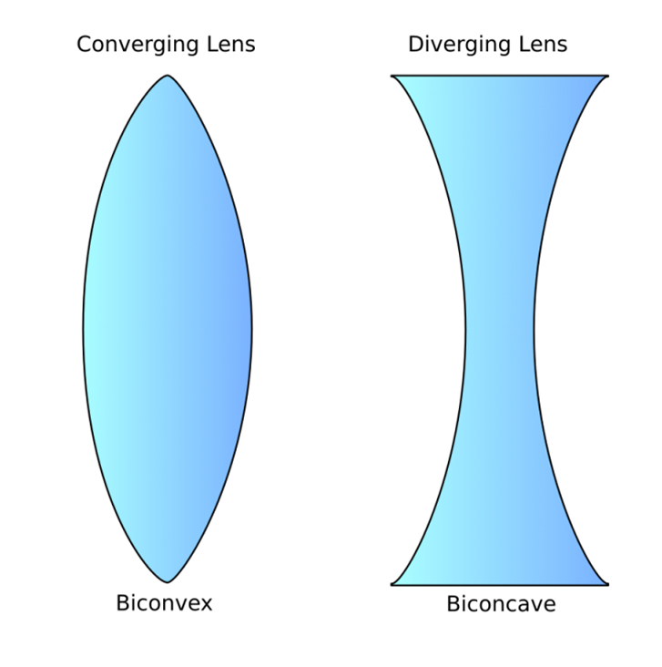

Spherical Lenses

Slide 9
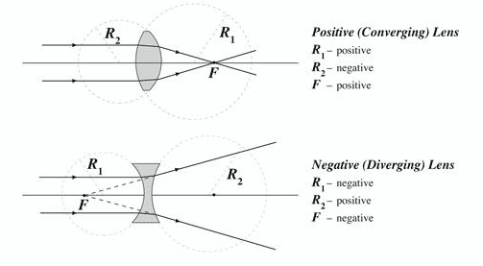

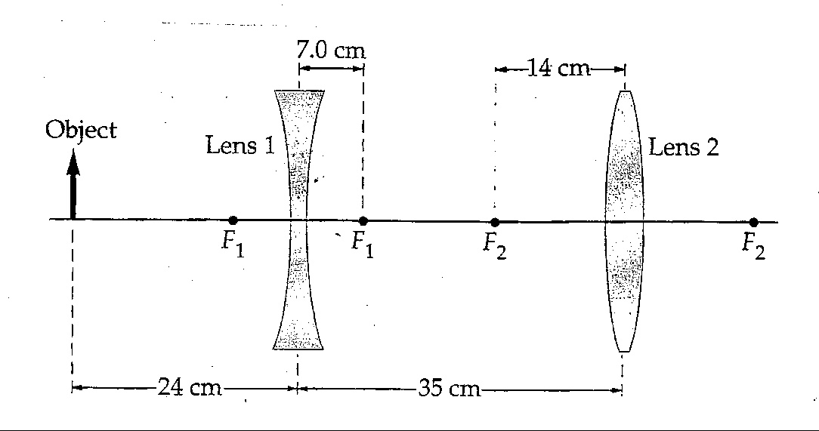
Lensmaker Equation + Sample Problem

Slide 10
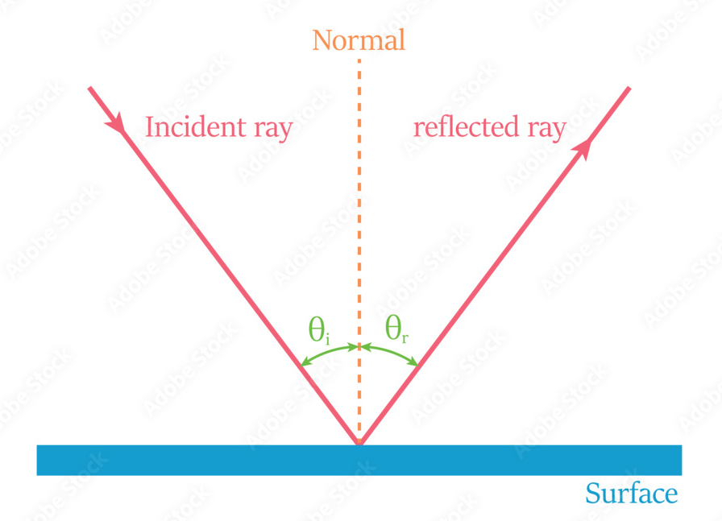
Reflection
Law of reflection: angle of incidence = angle of reflection

Slide 11
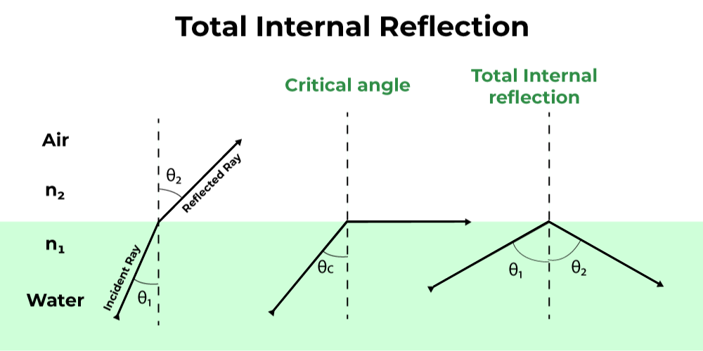
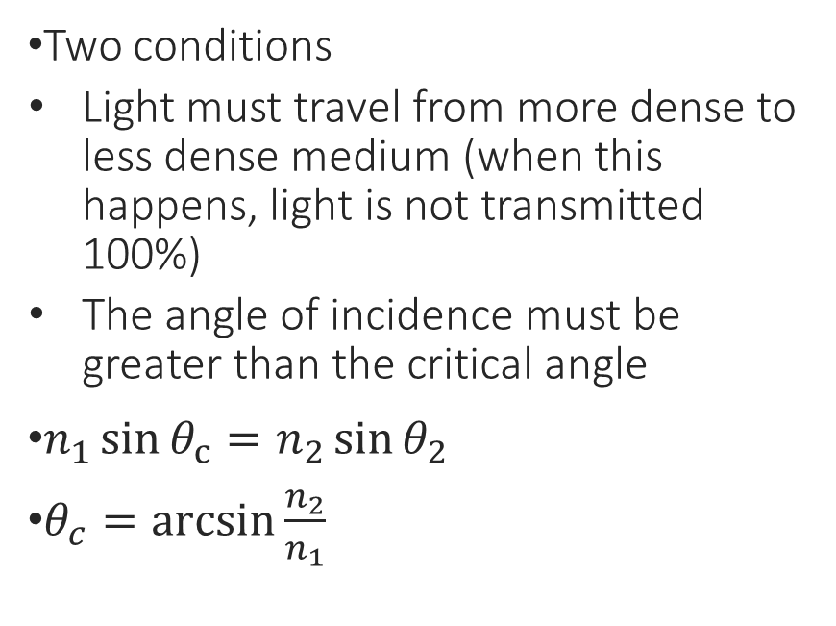
Total Internal Reflection

Slide 12
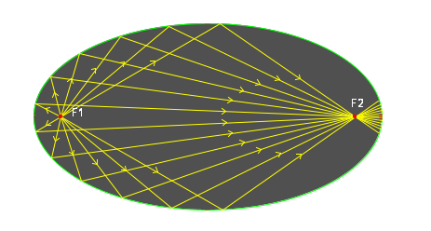
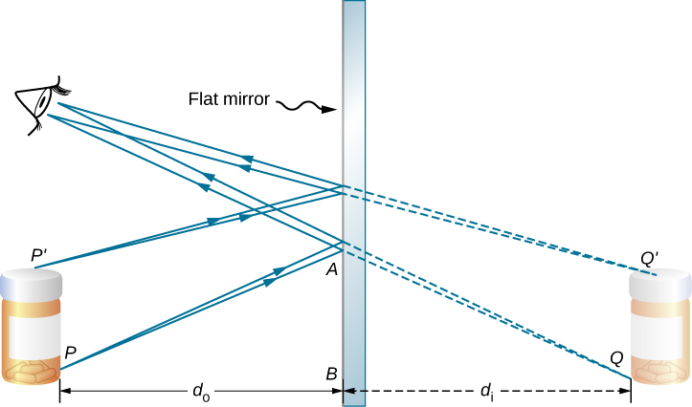
Flat and Elliptical Mirrors
Flat Mirror
  A simple example of a mirror, where distance to object and distance to image is equal
  Produces a virtual image
Elliptical Mirror
  Light originating from one focus will end up at the other focus
  Real image

Slide 13
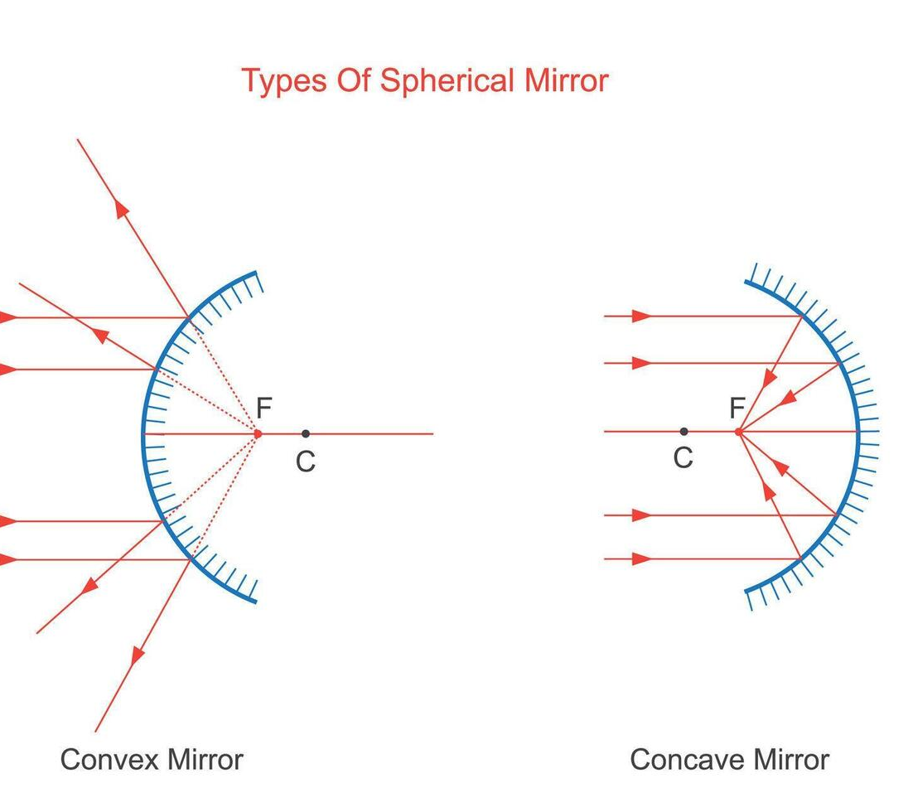
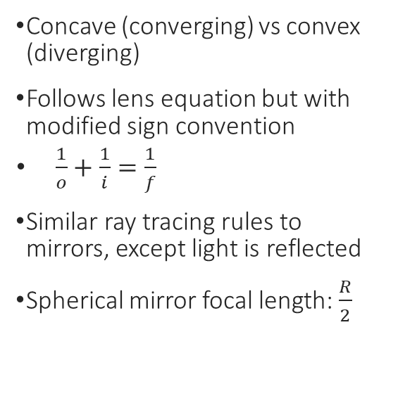
Parabolic (Spherical) Mirror

